Slide 1

Loan Application Analysis

Slide 2
Team Members
2010030362_Rushitha
2010030550_Kavya
Guided By:
K. Sreenivasa Rao

Slide 3

Table of Contents
Project Area
Literature Survey
Problem Statement
Python Integration
Conclusion

Slide 4
Project Area
Data visualization provides information to communicate with complex data relationships and data-driven insights in a way that is easy to understand. Kiva loans dataset mainly focuses on visualizations to quickly summarize loan data by graphs. The aim of this project is to provide an easy way to choose deserving applicants. It checks the applicant’s data and provides whether his/her loan can be approved or not as a result.

Slide 5
Literature Survey
S.No: | Authors | Title | Publishing | Techniques & Dataset | Pros | Cons
1. | Sheikh Mohammad Ahmad, Amit Kumar Goel, and Tapas Kumar. | An Approach for Prediction of Loan Approval using Machine Learning Algorithm | International Conference on Electronics and Sustainable Communication Systems (ICESC), pp. 490-494. IEEE, 2020. | Logistic regression, Bank customers dataset | Logistic regression is used for the description of data and to explain the relationship between a single binary variable and single or multiple nominal, ordinal, and ration level variables which are independent in nature. | Binning cannot be used for categorical columns, coz the labels that have low frequencies might be affected from the Robustness of statistical models in a negative manner.

Slide 6
S.No: | Authors | Title | Publishing | Techniques & Dataset | Pros | Cons
2. | P. Maheswari, and CH V. Narayana. | Predictions of Loan Defaulter - A Data Science Perspective | International Conference on Computing, Communication and Security (ICCCS), pp. 1-4. IEEE, 2020. | Principal Component Analysis (PCA). Lending club loan dataset | The classification techniques logistic regression, random forest and KNN model are built, so far three algorithms results similarly. Among them Logistic regression with SGD training results better predictions than the others. | K-Nearest Neighbor (KNN): The KNN algorithm takes more processing time for lagers datasets.
3. | Patel, Bhoomi, Harshal Patil, Jovita Hembram, and Shree Jaswal. | Loan Default Forecasting using Data Mining | In 2020 International Conference for Emerging Technology (INCET), pp. 1-4. IEEE, 2020. | Gradient Boosting Loan dataset | We can infer that Gradient Boosting and CatBoost Classifier is doing prediction well for the loan dataset. | Gradient boosting is a process consisting of multiple models. It is unusual to discard a variable as the interpretation of the variables is not straight. On the other hand, it is an accepted practice to eliminate variables while fitting logistic regression, even if it minimizes the overall model accuracy and prediction power.

Slide 7
S.No: | Authors | Title | Publishing | Techniques & Dataset | Pros | Cons
4. | Chang, Yung-Chia, Kuei-Hu Chang, and Yi-Xin Lin. | Establishment of Business Loan Default Prediction Model by Integrating Survival Analysis with Logistic Regression | Department of Industrial Engineering and Management, National Chiao Tung University, Hsinchu 300, Taiwan b, 2020. | Logistic regression Banking Dataset - Marketing Targets | Survival analysis is mainly for implementing in-depth discussions on the correlation between the survival time of a sample group and each variable. | The most significant difference between general linear regression and logistic regression lies in the “processible data attributes”; logistic regression could be applied for processing binary data and predicting its odds ratio for the occurrence of an event, regardless of whether the predictor variable is a categorical variable or continuous variable.
5. | Alaradi, Mohamed, and Sawsan Hilal. | Tree-Based Methods for Loan Approval | International Conference on Data Analytics for Business and Industry: Way Towards a Sustainable Economy (ICDABI), pp. 1-6. IEEE, 2020. | Synthetic Minority Oversampling Technique. Loan prediction dataset | Random forests technique has the advantage of de-correlating the constructed decision trees and hence reducing the variance when averaging the trees. | It performed less efferently in classifying the approved category with higher rates for false negatives which translates into the problem statement of this work as lost opportunity to grant a loan.

Slide 8
Problem Statement
Nowadays, several people apply for loans for various reasons. However, there are several cases where people do not repay the amount which causes huge financial loss. Today many banks / financial companies approve loans after a regress process of verification and validation but still, there is no surety whether the chosen applicant is the right applicant out of all applicants. We try to build a system that can classify the loaners among all, and it would prevent huge financial loss. The whole process of feature validation is automated by the machine learning technique.

Slide 9
ABSTRACT
Loans area unit the core business of banks. The most profit comes directly from the loan’s interest. The loan corporations grant a loan with an associate degree of intensive method of verification and validation. However, they still don’t have assurance if the customer is in a position to repay the loan with no difficulties. Loan Prediction is extremely useful for worker of banks similarly as for the customer additionally. The aim of this Project is to supply fast, immediate method for the eligible candidates. It will offer special advantage to the bank. The Loan Prediction System will calculate the load of every option participating in the loan process.

Slide 10
EXISTING WORK
In today’s world, obtaining loans from financial institutions has become a very common phenomenon. Every day many people apply for loans, for a variety of purposes. But not all the applicants are reliable, and not everyone can be approved. Every year, there are cases where people do not repay the bulk of the loan amount to the bank which results in huge financial loss. The risk associated with making a decision on a loan approval is immense. Hence, the idea of this project is to gather loan data and use machine learning techniques on this data to extract important information and predict if a customer would be able to repay the loan or not. In other words, the goal is to predict if the customer would be a defaulter or not. Considering the magnitude of risk and financial loss involved, it is essential for banks to give loans to credible applicants who are highly likely to pay back the loan amount.

Slide 11
PROPOSED WORK
Considering the financial institution’s situation whether or not they are willing to lend a loan to a client is a risky factor for them.
The following are the two most important banking issues:
1) What is the borrower's risk level?
2) Given the danger, should we credit to the borrower?
The lender's interest rate is determined by the answer to the first question. The interest rate, together with other factors (such as the payback period), assesses the borrower's riskiness; the higher the rate of interest, the riskier the consumer. depending upon the interest rate, we will determine if the applicant is eligible for the loan.

Slide 12
DATASET
DATASET DESCRIPTION:
It consists of these details - Gender, Marital Status, Education, Number of Dependents, Income, Loan Amount, Credit History and others.
TYPE OF DATA:
Categorical Columns: Gender (Male/Female), Married (Yes/No), Number of dependents (Possible values:0,1,2,3+), Education (Graduate / Not Graduate), Self-Employed (No/Yes), credit history(Yes/No), Property Area (Rural/Semi-Urban/Urban) and Loan Status (Y/N)(i. e. Target variable)
Numerical Columns: Loan ID, Applicant Income, Co-applicant Income, Loan Amount, and Loan amount term
URL:- https://www.kaggle.com/datasets/vipin20/loan-application-data
DATASET ROWS AND COLUMNS:
Training data - We have 614 rows and 13 columns.
Test data - We have 367 rows and 12 columns because the target column is not included in the test data.

Slide 13
METHODOLOGY
Logistic regression :- A very important approach in predictive analytics is used to study the problem of predicting loan defaulters: The Logistic regression model - data is collected from the Kaggle for studying and prediction. Logistic Regression models have been performed and the different measures of performances are computed. The models are compared on the basis of the performance measures such as sensitivity and specificity. The final results have shown that the model produce different results. Model is marginally better because it includes variables (personal attributes of customer like age, purpose, credit history, credit amount, credit duration, etc.) other than checking account information (which shows wealth of a customer) that should be taken into account to calculate the probability of default on loan correctly. Therefore, by using a logistic regression approach, the right customers to be targeted for granting loan can be easily detected by evaluating their likelihood of default on loan. The model concludes that a bank should not only target the rich customers for granting loan but it should assess the other attributes of a customer as well which play a very important part in credit granting decisions and predicting the loan defaulters.

Slide 14
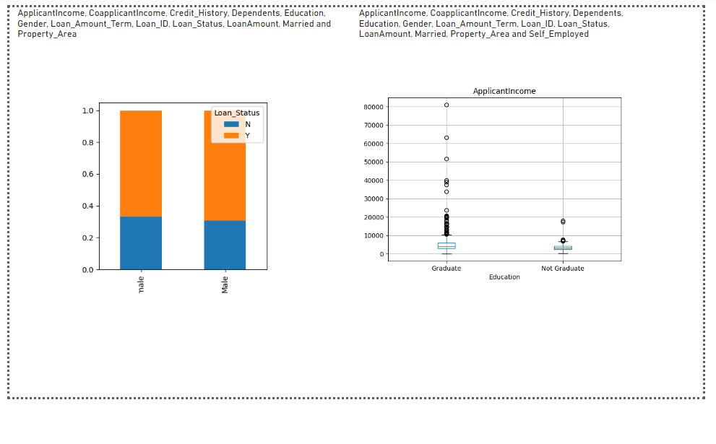
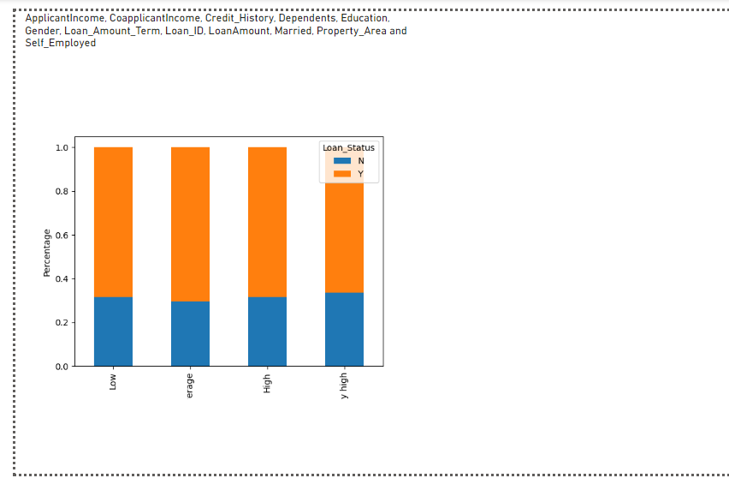
RESULTS
PYTHON INTEGRATION:

Slide 15
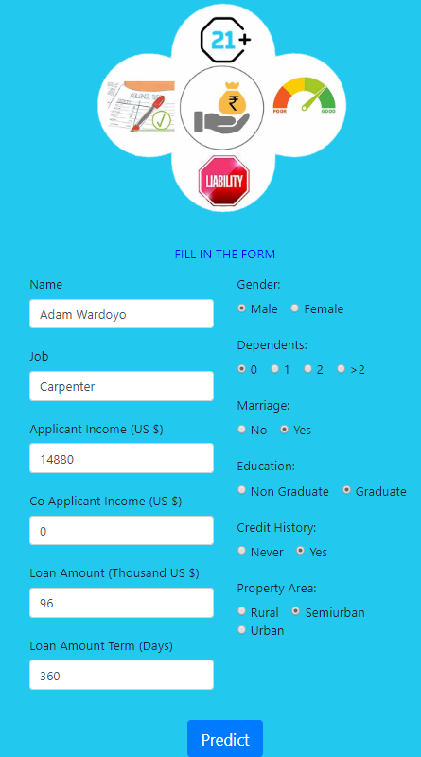
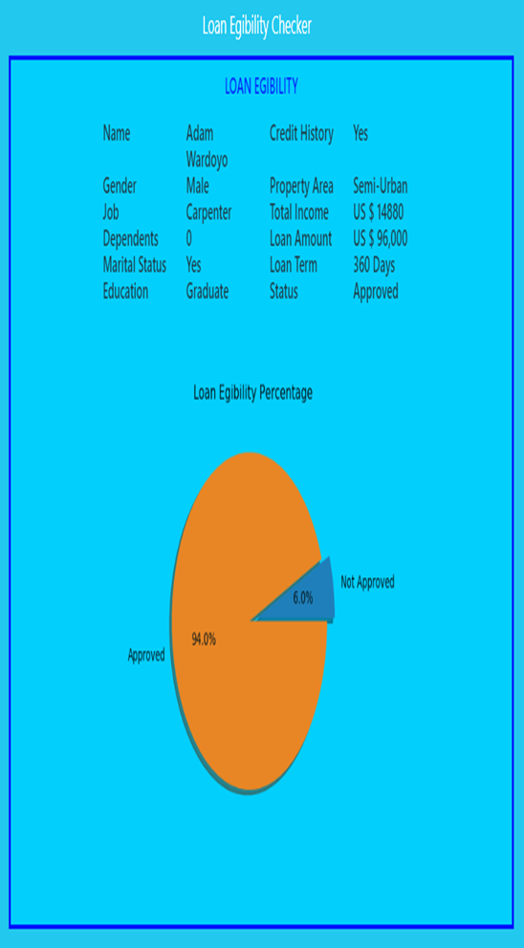
OUTPUT SCREENS

Slide 16
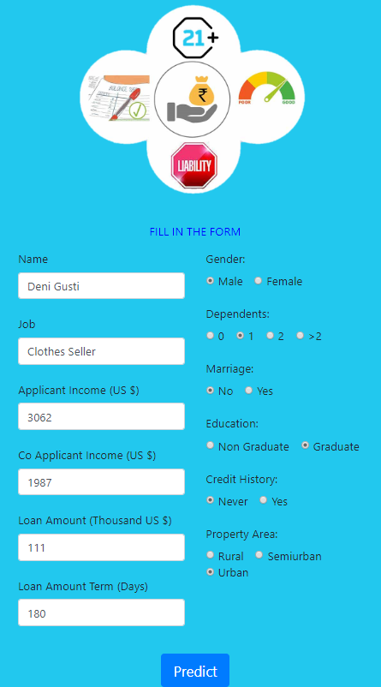
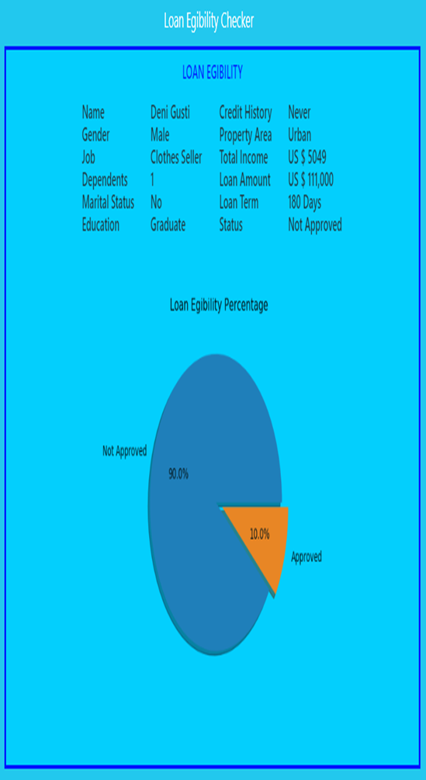

Slide 17
Conclusion
The main objective of the Project is to build a Loan Prediction Model that can shorten the loan approval time and decrease the risk associated with it. It is done by predicting if the loan can be given to that person on the basis of various parameters like credit score, income, age, marital status, gender, etc. The prediction model not only helps the applicant but also helps the bank by minimizing the risk. The loan application analysis system can assist the banks in making the best judgement on whether to approve or deny a customer's loan request.

Slide 18
THANK YOU

